Slide 1
Distributed Optimization Alternate Direction Method of Multipliers
Swapnil Saha, Brian B Cheng
ECE 509: Convex Optimization

Slide 2
Outline
Alternating direction method of multipliers (ADMM): Why it is powerful
Background: Dual Ascent and Method of Multipliers
Consensus Optimization
ADMM applied to LASSO
Distributed ADMM using MPI

Slide 3
Why ADMM is Powerful
Modular structure Decomposition of a large-scale optimization across objective components
Good robustness of convergence Restrictive convergence conditions and faster convergence rates

Slide 4

Why ADMM is Powerful
Decomposition of Dual Ascent
Robust Dual Decomposition
Robustness of Method of Multipliers

Slide 5
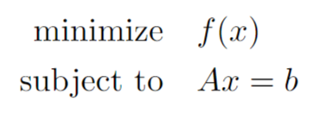
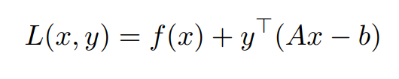

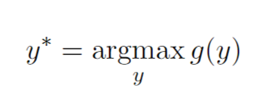
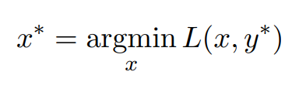
Dual Problem
Lagrangian
Dual Function
Strong Duality

Slide 6
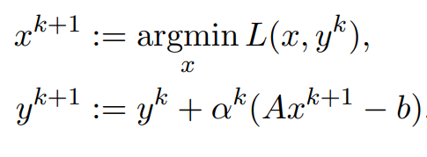
Dual Ascent
Variable Update

Slide 7
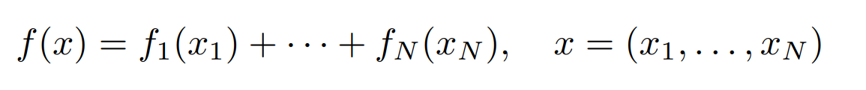
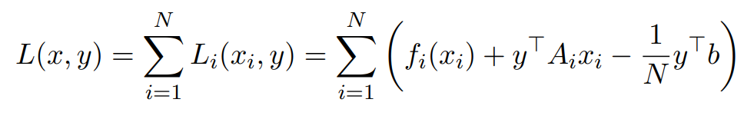
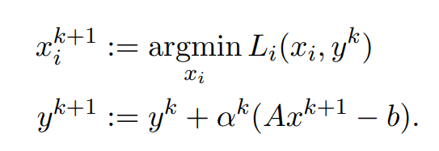
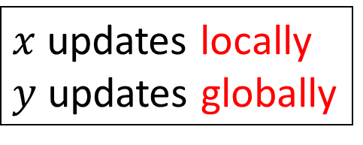
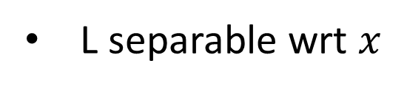
Dual Decomposition
f is separable
L separable wrt $x$
$x$ updates locally
$y$ updates globally

Slide 8
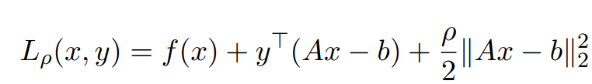
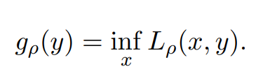
Method of Multipliers
Add robustness to solving dual problem
Use augmented Lagrangian
Differentiable under rather mild conditions
Dual Function
Notes:
The method of multipliers converges under far more general conditions than dual ascent, including cases when f takes on the value +∞ or is not strictly convex

Slide 9
Method of Multipliers
Improvement of convergence comes with the cost of losing decomposability
ADMM hits this drawbacks by introducing new variable and function
No longer sparable even though f(x) separable

Slide 10
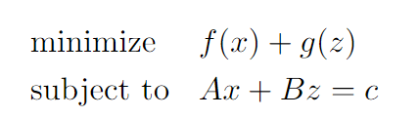
ADMM Method
Variable $z$ makes the Augmented Lagrangian separable.
Augmented Lagrangian

Slide 11
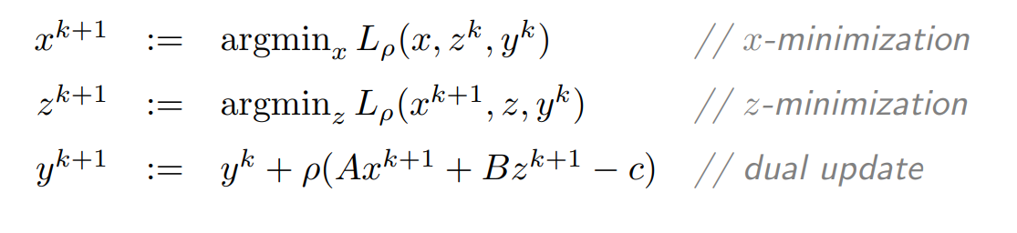
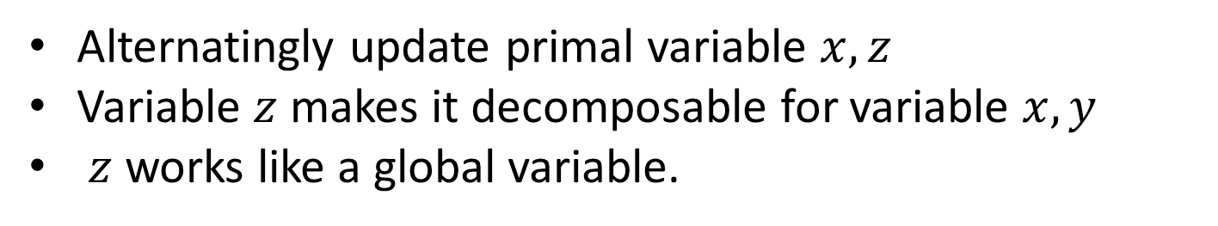
ADMM : Variable Update
Alternatingly update primal variable $x, z$
Variable $z$ makes it decomposable for variable $x, y$
$z$ works like a global variable.

Slide 12
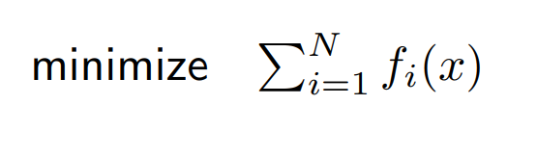
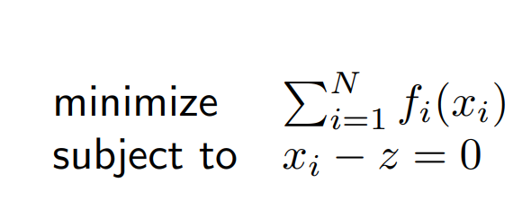
ADMM : Decomposability
Consensus Optimization: Objective function is distributed through N nodes.
One “single” $x$ collaboratively decrease overall objective function.
ADMM Format: Distributed the variable x to each nodes.
Creating Local Variable
Constraint makes them agree to each other

Slide 13
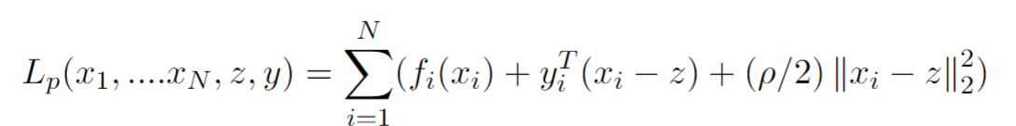
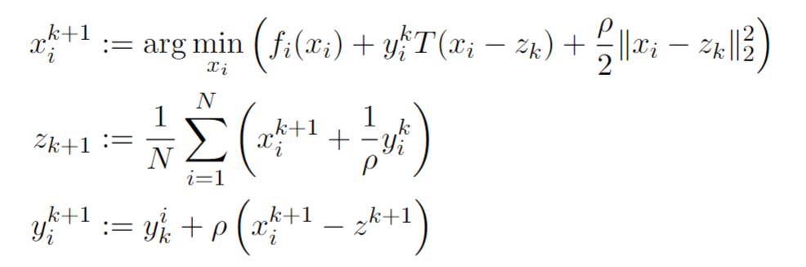
Consensus Problem with ADMM
Augmented Lagrangian
ADMM Update: Subscript i indicating i-th local node

Slide 14
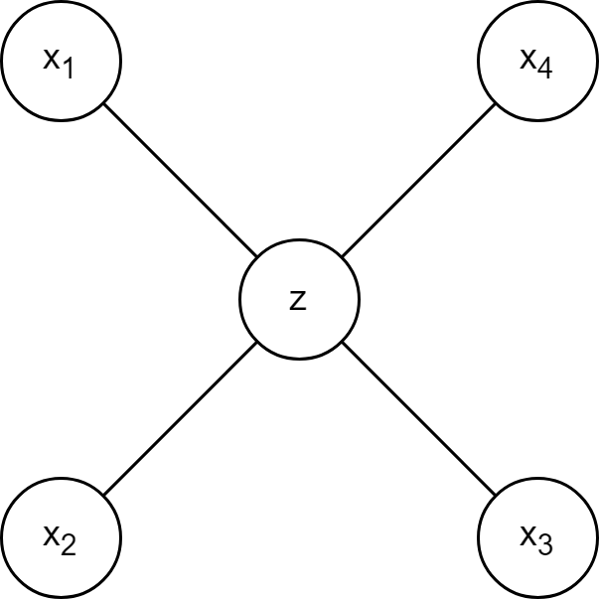
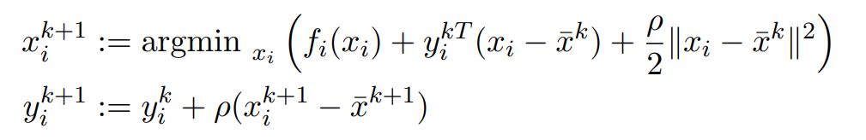

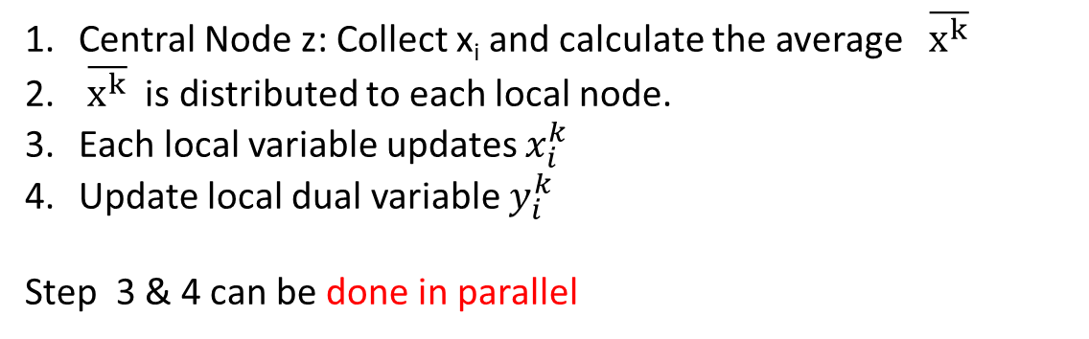
Intuition of ADMM Update
ADMM update can be rewritten as follows
$$z^{k}=\overline{x^{k}}$$
Central Node z: Collect x_{i} and calculate the average $\overline{x^{k}}$
$\overline{x^{k}}$ is distributed to each local node.
Each local variable updates $x_{i}^{k}$
Update local dual variable $y_{i}^{k}$
Step 3 & 4 can be done in parallel
Consensus Setup

Slide 15


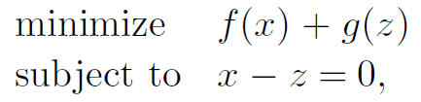

ADMM Applied to LASSO Regression
ADMM General Form:
LASSO Objective Function:
ADMM LASSO Problem:

Slide 16
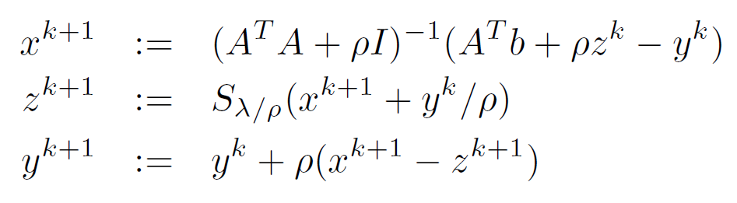

ADMM Lasso Algorithm
Lasso Obj. Function: f(x) + g(z) =
Augmented Lagrangian:
A = I, B = -I, c = 0
ADMM Algorithm Applied to LASSO:
// Soft thresholding operator
$$r^{k+1}=x^{k+1}−z^{k+1}$$
Primal and Dual Residuals:
$$s^{k+1}=ρ\left(z^{k+1}−z^{k}\right)$$

Slide 17
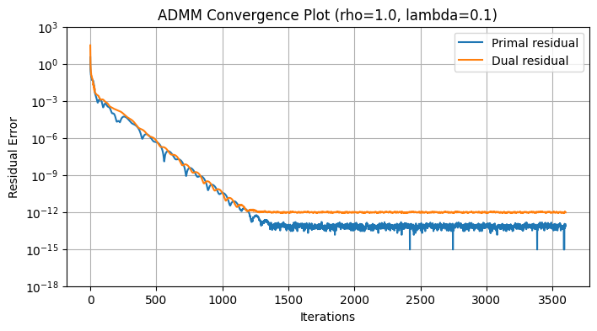
Simulation: ADMM Lasso Experiment
Most simple case
Single node, no distribution
A = 1200x1200 matrix
Dense: All elements generated with normal distribution
Slow convergence
But fast enough for many practical applications
Can vary with properties of the input matrix (tallness, wideness, sparsity, etc.)

Slide 18


Distributed ADMM Lasso Algorithm
Lasso Obj. Function:
Dist. Augmented Lagrangian:
Distributed ADMM Applied to LASSO:
// soft threshold of x_avg and u_avg
$$r_{i}^{k+1}=x_{i}^{k+1}−z^{k+1}$$
Primal and Dual Residuals:
$$s_{i}^{k+1}=ρ\left(z^{k+1}−z^{k}\right)$$

Slide 19
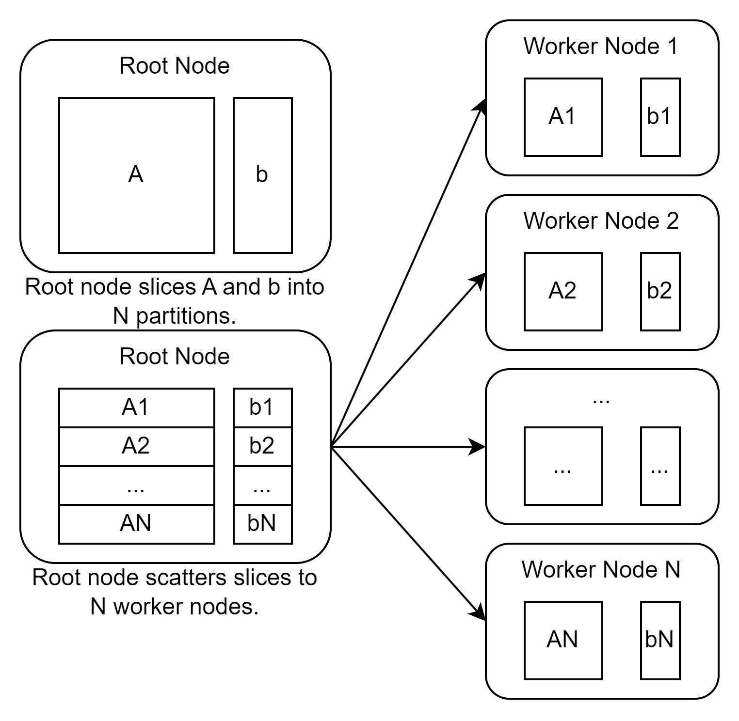
Message Passing Interface (MPI)
Before the algorithm starts, the root node broadcasts partitions of the input matrix A and vector b to each of the worker nodes.
Here, the input matrix is split among examples.
Comm.Scatter(A, local_A)
Comm.Scatter(b, local_b)

Slide 20
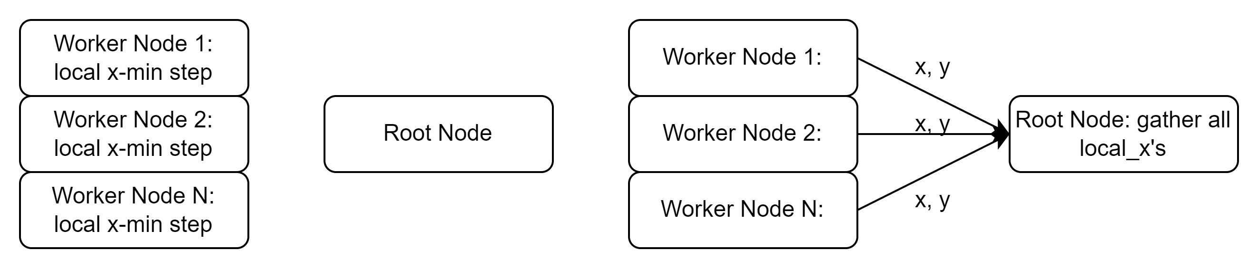
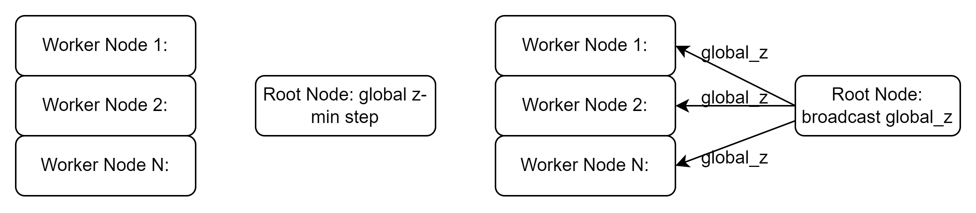
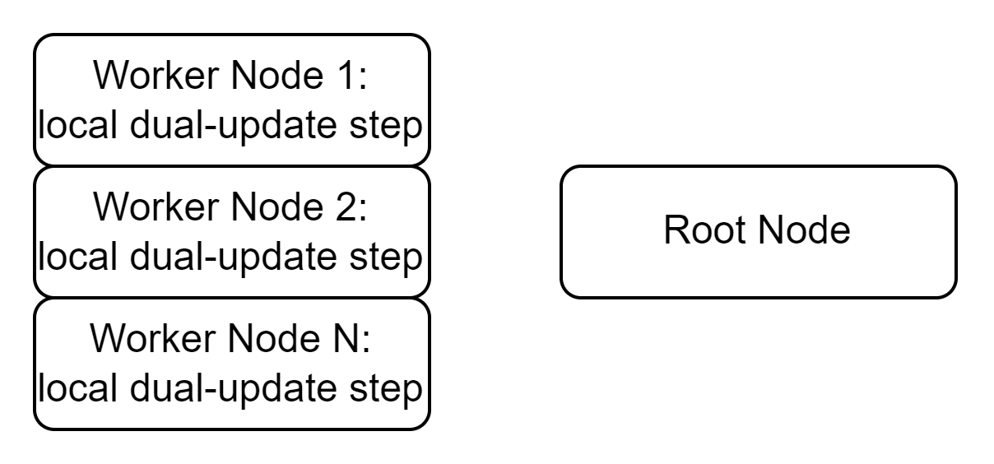
Global Consensus
Comm.Gather(all_x, local_x)
The worker nodes have their local partitions of the dataset and work on their own local x-min and y-min steps.
The z-min step acts as the global consensus step
X-min step:
Z-min step:
Comm.Broadcast(z, global_z)
Y-update step:
Check stopping criterion.
Loop if criterion not met

Slide 21
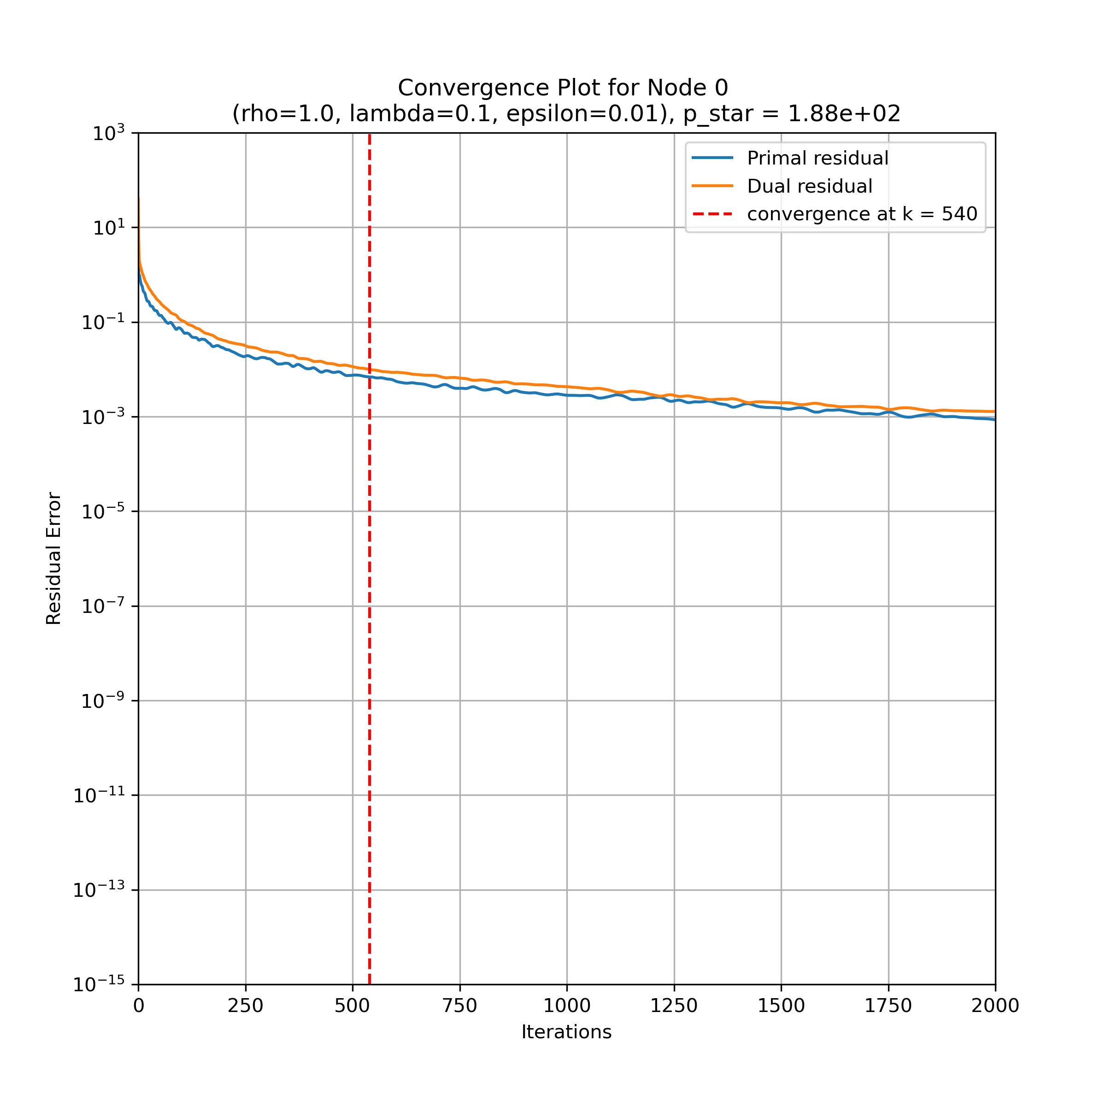
Single Node Simulation Result
Before running distributed test, run a single node test as validation.
LASSO Regression Single Node Test:
Dataset A = 2000x4000
Wide, Dense
Dataset splitting strategy:
Split across examples
Each node receives a horizontal partition of dataset

Slide 22
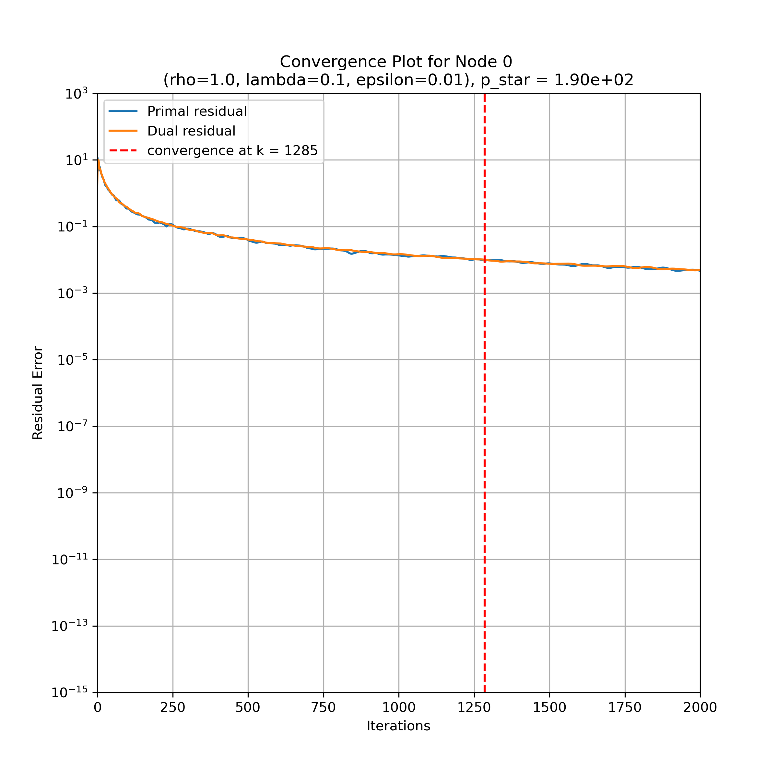
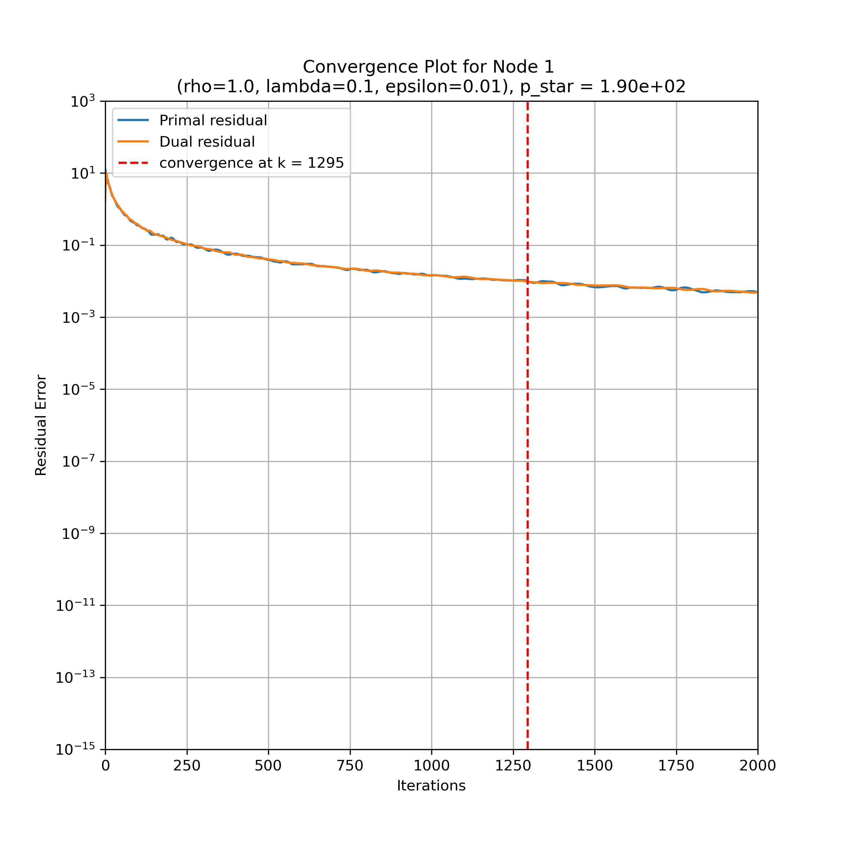
Distributed Simulation Node 0 and 1 Result

Slide 23
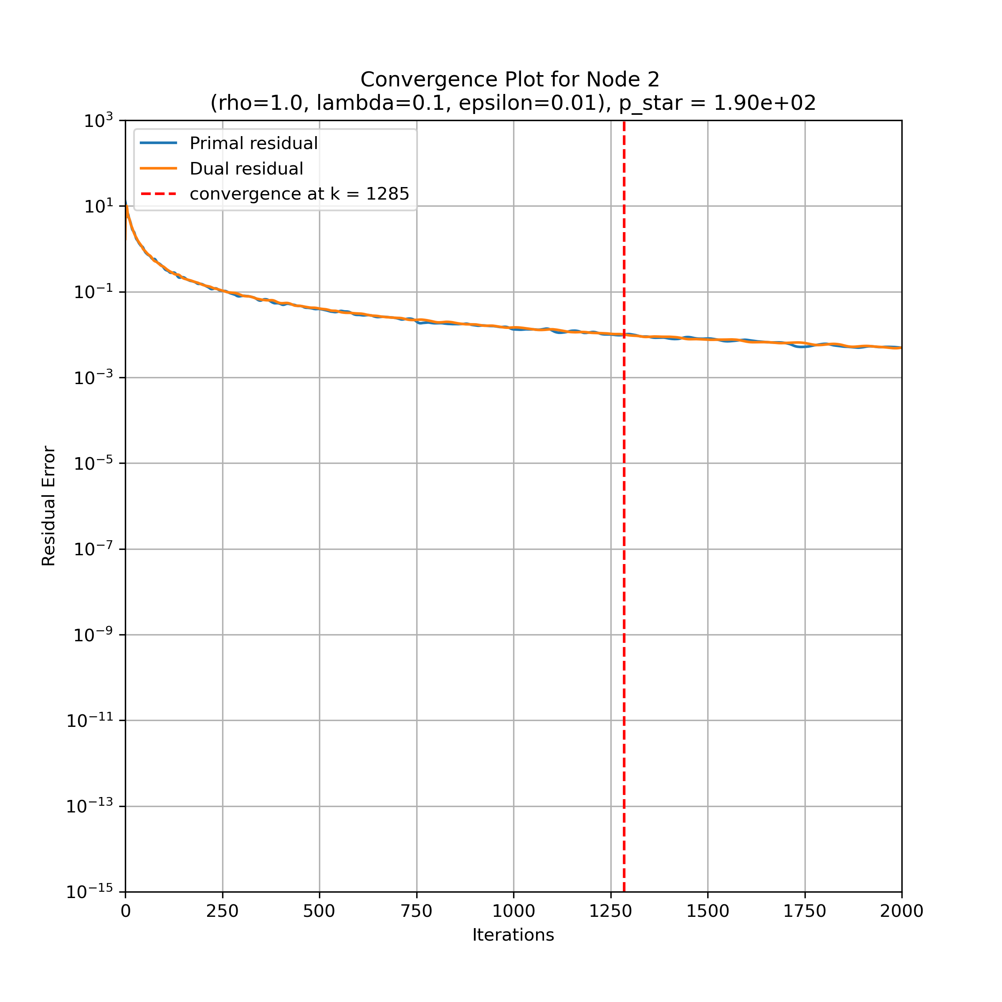

Distributed Simulation Node 2 and 3 Result

Slide 24

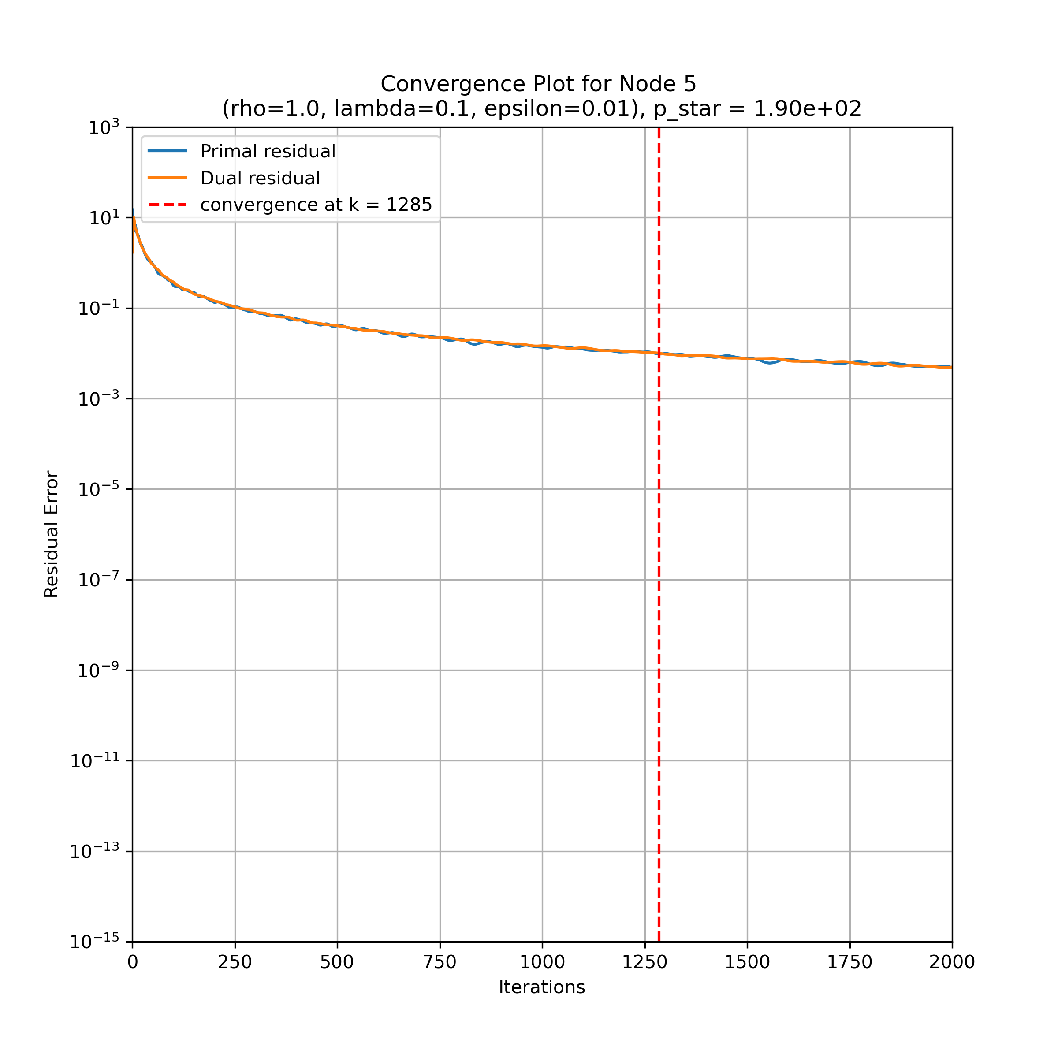
Node 4 and 5 Result

Slide 25


Node 6 and 7 Result

Slide 26


Node 8 and 9 Result

Slide 27
Future Work
Test different input matrices A
Dense vs Sparse matrices
We only experimented with dense matrices
Tall matrix vs wide matrix
ADMM seems to converge with higher precision on tall and square matrices (residual ~10e-12), but with low precision on wide matrices (residual ~10e-3)
Very large matrices e.g. (400000x1000)
Large enough that the entire dataset does not fit into fast memory on a single node
Large enough that the performance boost of distribution outweighs the MPI data transfer overhead
Faster matrix inversion methods
Cholesky Factorization

Slide 28
END

Slide 29
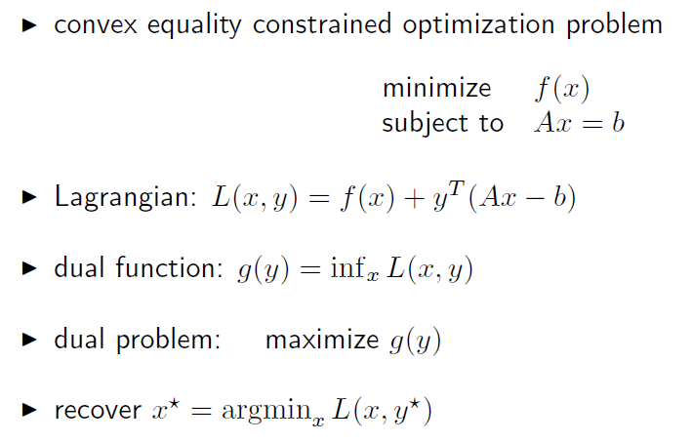
BACKUP: Dual Problem

Slide 30
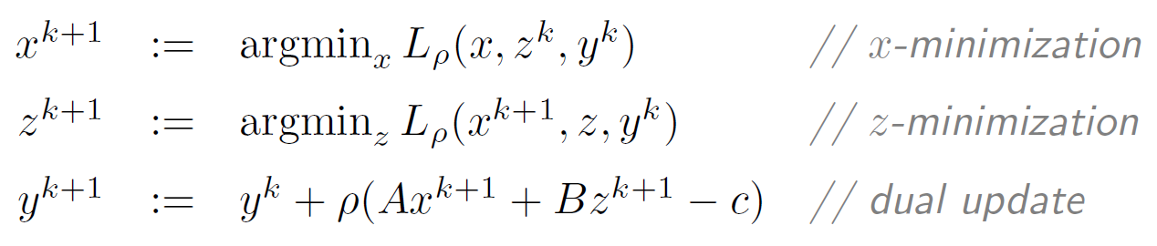
BACKUP: ADMM Lasso Algorithm
Augmented Lagrangian:
ADMM Algorithm General Form:
Lasso Obj. Function: f(x) + g(z) =
A = B = I, c = 0
ADMM Algorithm Applied to LASSO:
// Soft thresholding operator

Slide 31
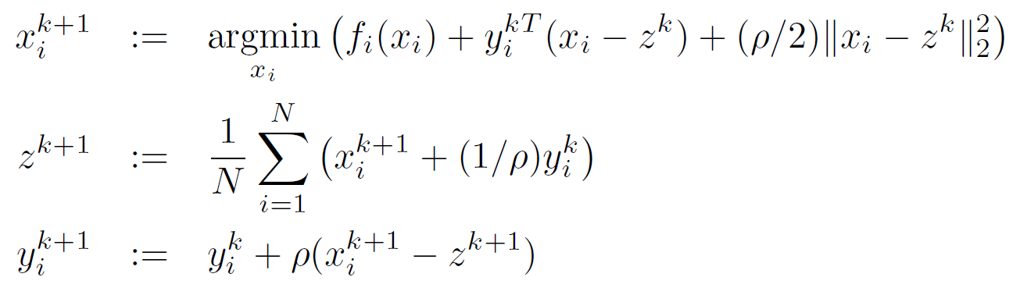
BACKUP: Distributed ADMM Lasso Algorithm
Dist. Augmented Lagrangian:
Dist. ADMM Algorithm General Form:
ADMM Algorithm Applied to LASSO:
// soft threshold of x_avg and u_avg

